Slide 1
SPARK- Specialized Parkinson’s Augmented Reality Kit
By-Priyadarshini Pal 19BCE1518
Varan Gulati 19BCE1422
Rahul Garg 19BCE1531
Vaasu Bhatnagar 19BCE1420

Slide 2
Purpose:
Parkinson's patients have trouble controlling their movements. Yet, when visual cues are here to guide them, motor control is enhanced. Patients even said "If you get me up a flight of stairs I'd be up no problem at all. These problems lead to loss of independence and reduced quality of life like they sufferers often avoid activities outside of the home, leading to isolation and depression.
So we are planning to build an augmented reality prototype designed to help these people with Parkinson's Disease navigate environments using visual cues to reduce their dependency.

Slide 3
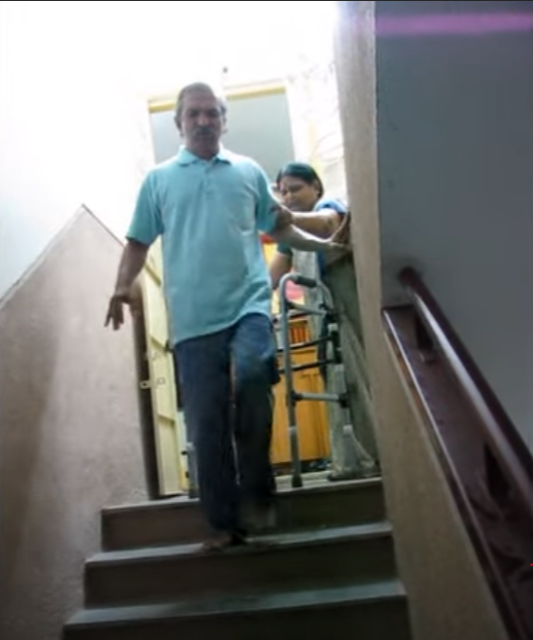
Parkinson’s patient walking easily on stairs :

Slide 4
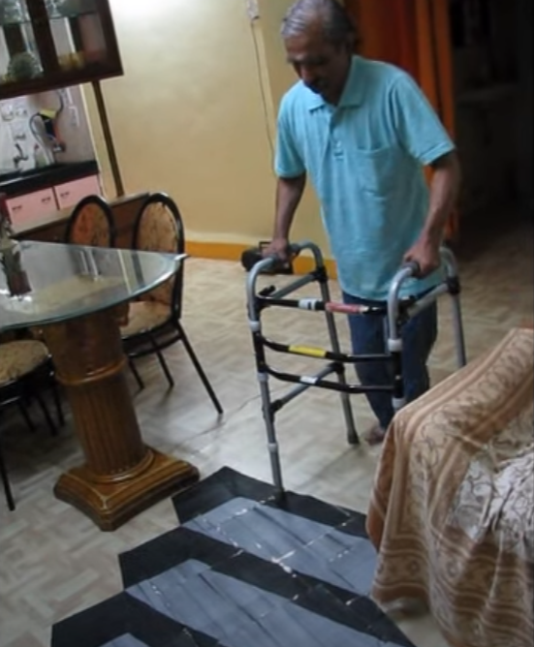
Simulating stairs on flat surface by drawing :

Slide 5
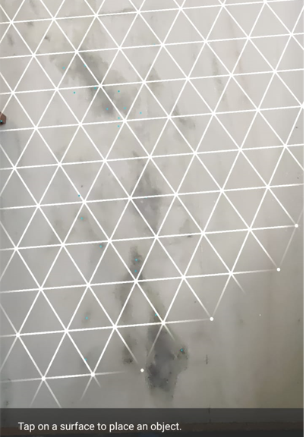
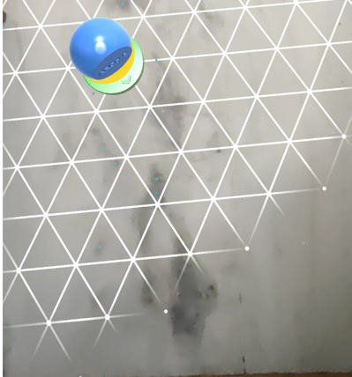
Work Done previously:
A simple prototype app where we tried detecting the plane/floor surface and upon successful detection placed a small default object on that detected surface

Slide 6
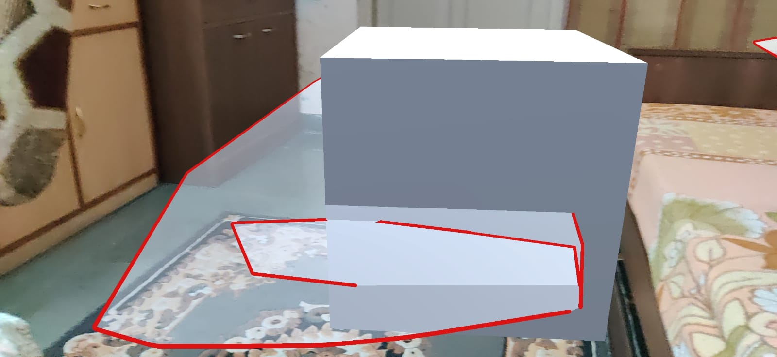
Failed attempt :
Tried changing the plane detection pattern and placing custom made cube on the detected surface but failed to correctly gauge the floor coordinates resulting in the object being spawned halfway down the floor

Slide 7
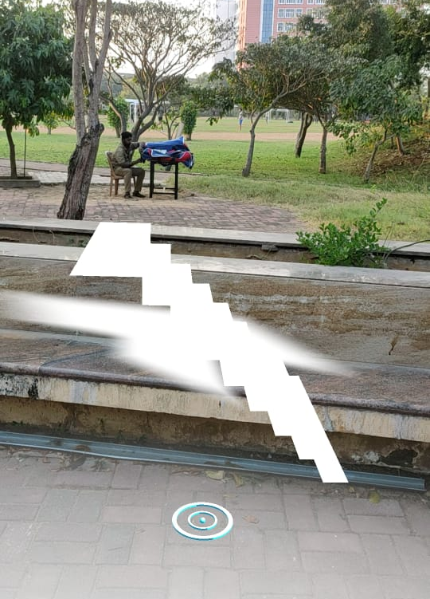
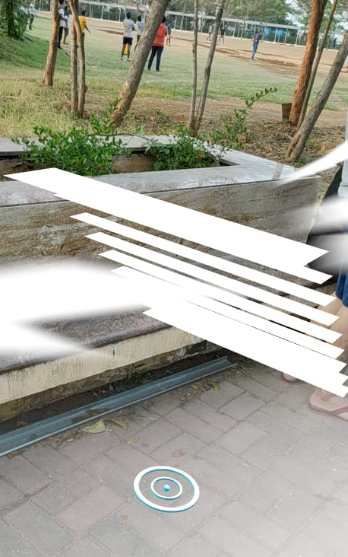
3D Stairs added to the ar world :

Slide 8

Final Demonstration
Run on the Slide Show and Click Once on the Black Screen to start the video

Slide 10
THANK YOU!!

